Slide 1

Elimination Tournament
Round 4
6th Annual WSMA Math Bowl
January 23rd, 2016
This test material is copyright © 2016 by the Washington Student Math Association and may not be distributed or reproduced other than for nonprofit educational purposes without the expressed written permission of WSMA. www.wastudentmath.org.

Slide 2
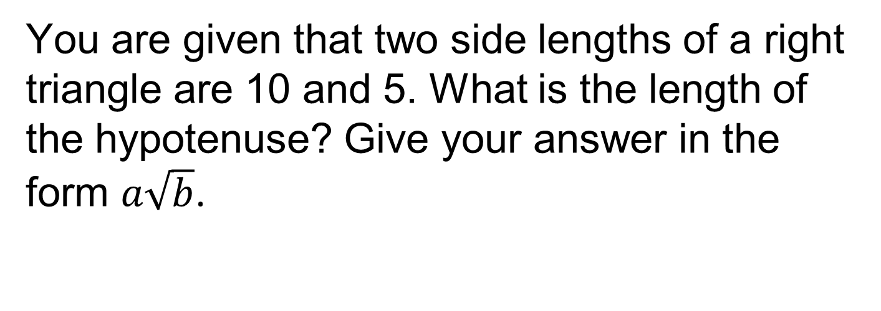
Problem 1
You are given that two side lengths of a right triangle are 10 and 5. What is the length of the hypotenuse? Give your answer in the form $a\sqrt{b}$.
Copyright © 2016 by the Washington Student Math Association

Slide 3
Problem 2
If the diameter of a sphere is 10, what is the volume of the sphere?
Copyright © 2016 by the Washington Student Math Association

Slide 4
Problem 3
What is 13² - 2(5² - 3)?
Copyright © 2016 by the Washington Student Math Association

Slide 5
Problem 4
The sum of the first eighty positive odd integers subtracted from the sum of the first eighty positive even integers is?
Copyright © 2016 by the Washington Student Math Association

Slide 6
Problem 5
What is the probability of rolling a sum of 6 after rolling 2 fair 6-sided dice?
Copyright © 2016 by the Washington Student Math Association

Slide 7
Problem 6
What is 666₁₀ in base 9?
Copyright © 2016 by the Washington Student Math Association

Slide 8
Problem 7
If an equilateral triangle has side length 6, what is its area?
Copyright © 2016 by the Washington Student Math Association

Slide 9
Extra Question
Find the next number in the pattern 11, 18, 27, 38?
Copyright © 2016 by the Washington Student Math Association

