Slide 1

Middle School Elimination Tournament
Round 4
5th Annual WSMA Math Bowl
March 7th, 2015
This test material is copyright © 2015 by the Washington Student Math Association and may not be distributed or reproduced other than for nonprofit educational purposes without the expressed written permission of WSMA. www.wastudentmath.org.

Slide 2

Problem 1
Find the roots of:
$$15x^{2}−38x+7$$
Copyright © 2015 by the Washington Student Math Association

Slide 3
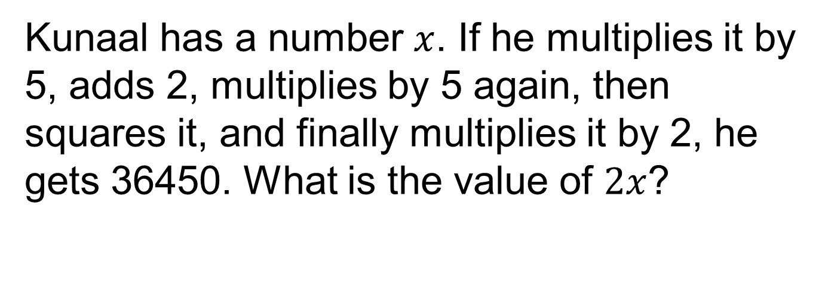
Problem 2
Kunaal has a number $x$. If he multiplies it by 5, adds 2, multiplies by 5 again, then squares it, and finally multiplies it by 2, he gets 36450. What is the value of $2x$?
Copyright © 2015 by the Washington Student Math Association

Slide 4
Problem 3
What is the angle, in degrees, formed by the minute and hour hands of an analog clock at 5:30 pm?
Copyright © 2015 by the Washington Student Math Association

Slide 5

Problem 4
Find the product of the missing terms of the geometric sequence __, __, $\frac{27}{64},\frac{81}{256},\frac{243}{1024},\frac{729}{4096}$
Copyright © 2015 by the Washington Student Math Association

Slide 6
Problem 5
With the digits from 0 through 5 inclusive, how many 6 digit numbers could I make?
Copyright © 2014 by the Washington Student Math Association

Slide 7
Problem 6
John the chemist is converting elements. Given that one aluminum equals three chromiums, four chromiums equal two bromines, six bromines equal eight fluorines, and two fluorines equal five germaniums, how many aluminums equal twenty germaniums?
Copyright © 2015 by the Washington Student Math Association

Slide 8
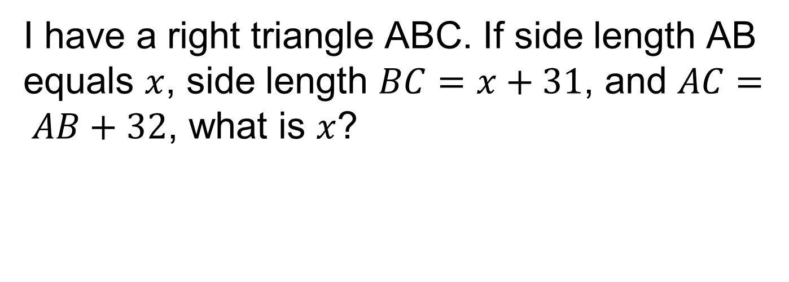
Problem 7
I have a right triangle ABC. If side length AB equals $x$, side length $BC=x+31$, and $AC= AB+32$, what is $x$?
Copyright © 2014 by the Washington Student Math Association

Slide 9
Extra Question
What is the distance from the intersection of two angle bisectors to the third side of a triangle with lengths 2.5, 2.5, 3?
Copyright © 2015 by the Washington Student Math Association

