Slide 1

Middle School Elimination Tournament
Round 3
5th Annual WSMA Math Bowl
March 7th, 2015
This test material is copyright © 2015 by the Washington Student Math Association and may not be distributed or reproduced other than for nonprofit educational purposes without the expressed written permission of WSMA. www.wastudentmath.org.

Slide 2
Problem 1
A cow must choose two different pastures to eat from for lunch and dinner. If there are 6 total pastures, how many ways can a cow eat lunch and dinner?
Copyright © 2015 by the Washington Student Math Association

Slide 3
Problem 2
Krishna is playing games. If every minute he plays games, his nose grows 2 inches, how much time did he play games if his nose grew 18 feet in minutes?
Copyright © 2015 by the Washington Student Math Association

Slide 4
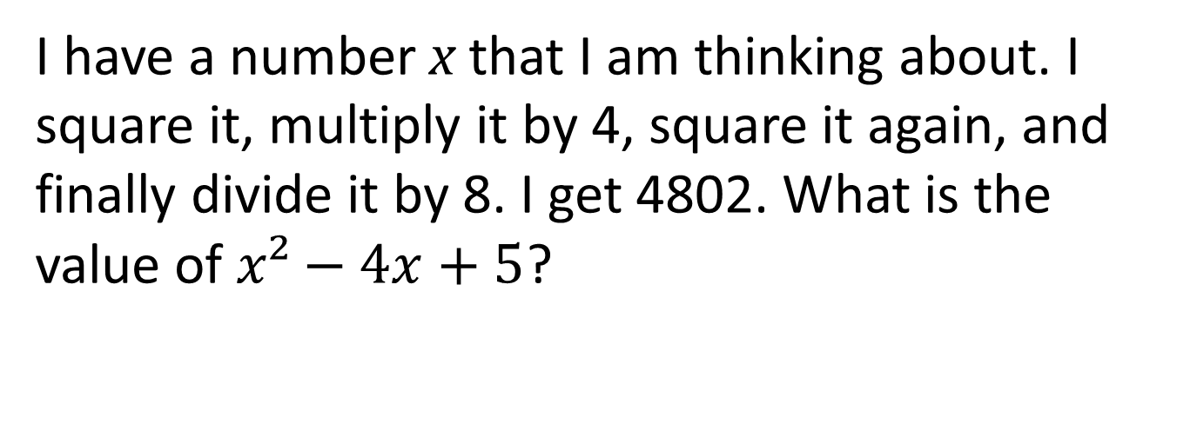
Problem 3
I have a number x that I am thinking about. I square it, multiply it by 4, square it again, and finally divide it by 8. I get 4802. What is the value of $x²−4x+5$?
Copyright © 2014 by the Washington Student Math Association

Slide 5

Problem 4
Evaluate the following:
$$6!−5!+4!−3!+2!−1!+0!$$
Copyright © 2015 by the Washington Student Math Association

Slide 6
Problem 5
On any given day in January, the probability that it will rain is 0.6. What is the probability in decimal form that it will only rain on Monday, Wednesday and Friday in the first week of January?
Copyright © 2015 by the Washington Student Math Association

Slide 7
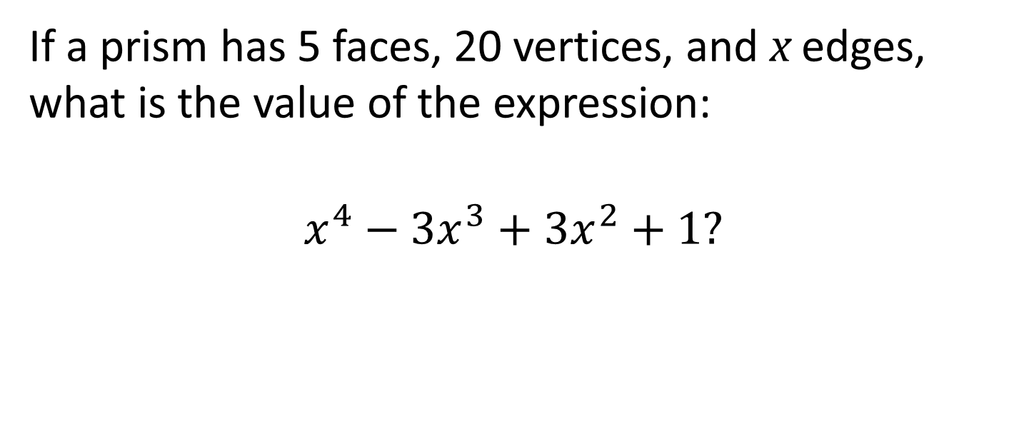
Problem 6
If a prism has 5 faces, 20 vertices, and x edges, what is the value of the expression:
$$x^{4}−3x^{3}+3x^{2}+1?$$
Copyright © 2015 by the Washington Student Math Association

Slide 8

Problem 7
What is $1+½+¼+⅛+…?$
Copyright © 2015 by the Washington Student Math Association

Slide 9
Extra Question
Find the slope of y = 2(x-2) + 3 at the point (2,3)
Copyright © 2015 by the Washington Student Math Association

