Slide 1

High School Elimination Tournament
Final Round
5th Annual WSMA Math Bowl
March 7th, 2015
This test material is copyright © 2015 by the Washington Student Math Association and may not be distributed or reproduced other than for nonprofit educational purposes without the expressed written permission of WSMA. www.wastudentmath.org.

Slide 2
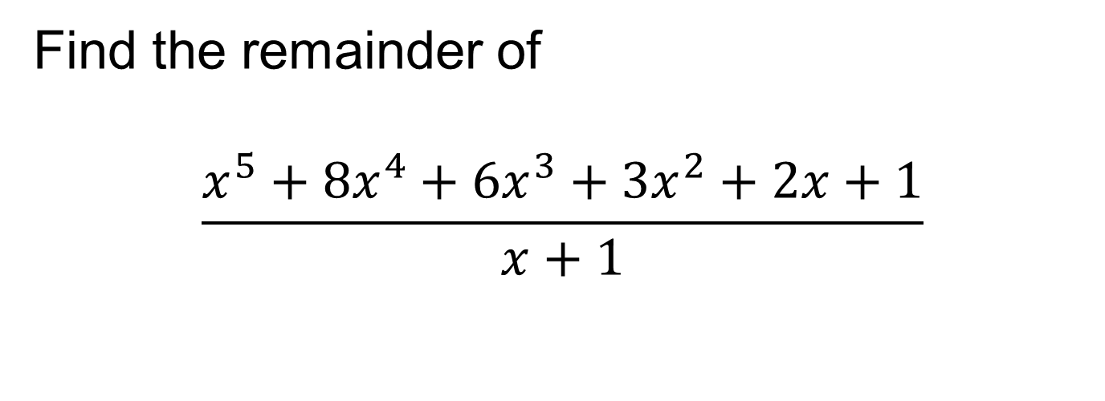
Problem 1
Find the remainder of
$$\frac{x^{5}+8x^{4}+6x^{3}+3x^{2}+2x+1}{x+1}$$
Copyright © 2015 by the Washington Student Math Association

Slide 3

Problem 2
$x^{3}−{13x}^{2}+39x+k=0$, and the roots of x forms a geometric sequence. What is the value of k?
Copyright © 2015 by the Washington Student Math Association

Slide 4
Problem 3
Which of the following numbers are prime: 161, 237, 613, 781, and 1117?
Copyright © 2015 by the Washington Student Math Association

Slide 5
Problem 4
If Krishna can mow a lawn in 2 hours, Steven in 1:30 hours, and Romil in 30 minutes, how long would it take the three of them to mow one lawn?
Copyright © 2015 by the Washington Student Math Association

Slide 6
Problem 5
If the hour hand is covered by the minute hand in a clock, but you know it is past 5, to the nearest minute, what is the time?
Copyright © 2015 by the Washington Student Math Association

Slide 7

Problem 6
What is the value of $({2−2i)}^{2014}$? You can leave the answer in exponential form.
Copyright © 2015 by the Washington Student Math Association

Slide 8
Problem 7
What is the radius of the inscribed circle of a triangle with side lengths 10, 24, and 26?
Copyright © 2015 by the Washington Student Math Association

Slide 9
Problem 8
When it is 1:00 AM in London, it is 2:00 AM in Paris. If Mathland is as far west from London as Paris is east of London, what time is it in Mathland?
Copyright © 2015 by the Washington Student Math Association

Slide 10
Problem 9
What is the probability of getting this question correct?

Slide 11
Problem 10
If two lines never intersect, must they be parallel?

Slide 12
Problem 11
What are the sum of the primes under 9 that divide 1999224?

Slide 13
Problem 12
If A=>1, B=>2… Z=>26, what is the sum of the value WSMAMATHBOWL?

Slide 14
Problem 13
If there are 9 sigs to 16 wigs, and 8 pigs to 2 sigs, and 3 ligs to 7 pigs, how manys ligs are 112 wigs?

Slide 15
Problem 14
How many zeros does 150! have at the end?

Slide 16

Problem 15
What is the smallest positive number that $184x−364y$ cannot equal?

Slide 17
Problem 16
What is the tens digit of the product of all positive factors of 2015, excluding itself?

