Slide 1

High School Elimination Tournament
Round 2
5th Annual WSMA Math Bowl
March 7th, 2015
This test material is copyright © 2015 by the Washington Student Math Association and may not be distributed or reproduced other than for nonprofit educational purposes without the expressed written permission of WSMA. www.wastudentmath.org.

Slide 2
Problem 1
In how many ways you can start at the origin and move to the point (1, 2) while only moving on lattice paths such that your path is 5 units or less? (A lattice path is a point at which the x and y values of the coordinates are integers.)
Copyright © 2015 by the Washington Student Math Association

Slide 3
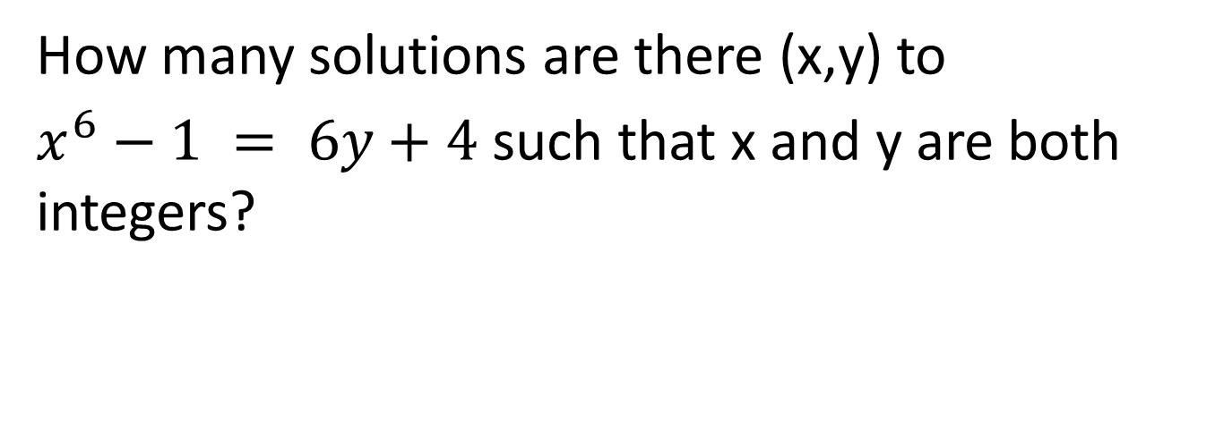
Problem 2
How many solutions are there (x,y) to
$x^{6}−1 = 6y+4$such that x and y are both integers?
Copyright © 2015 by the Washington Student Math Association

Slide 4
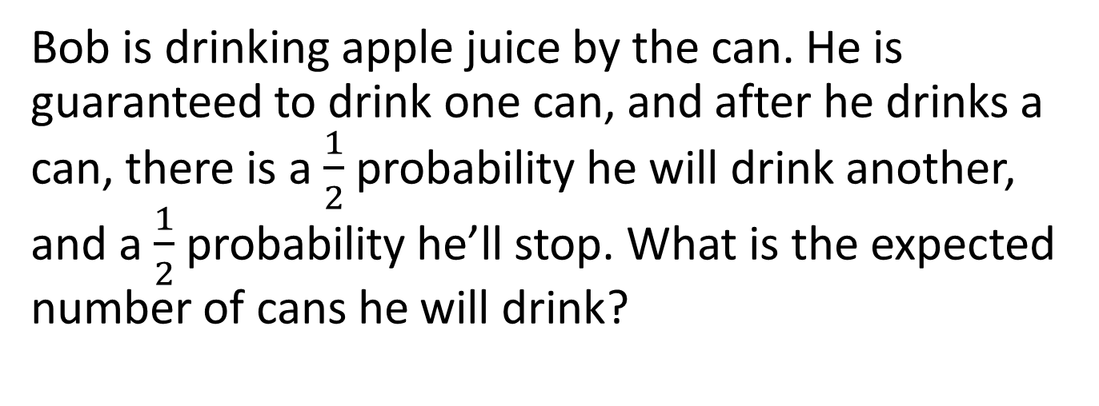
Problem 3
Bob is drinking apple juice by the can. He is guaranteed to drink one can, and after he drinks a can, there is a $\frac{1}{2}$ probability he will drink another, and a $\frac{1}{2}$ probability he’ll stop. What is the expected number of cans he will drink?
Copyright © 2015 by the Washington Student Math Association

Slide 5

Problem 4
Find the largest power of three that divides:
$4^{9}$-1
Copyright © 2015 by the Washington Student Math Association

Slide 6
Problem 5
Find the radius of a circle inscribed in a regular hexagon with a side length of 3.
Copyright © 2015 by the Washington Student Math Association

Slide 7
Problem 6
What is the converse of this statement: If I solve math problems, I am a mathlete.
Copyright © 2015 by the Washington Student Math Association

Slide 8

Problem 7
Find the positive difference of ($1^{2}+2^{2}+3^{2}+4^{2}+5^{2}$) and ($1+2+3+4+5)2$.
Copyright © 2015 by the Washington Student Math Association

Slide 9
Extra Question
Laura has a 17 cent coin and a 5 cent coin. What is the largest amount of change she cannot make?
Copyright © 2015 by the Washington Student Math Association

