Slide 1

High School Mental Math
5th Annual WSMA Math Bowl
March 7th, 2015
This test material is copyright © 2015 by the Washington Student Math Association and may not be distributed or reproduced other than for nonprofit educational purposes without the expressed written permission of WSMA. www.wastudentmath.org.

Slide 2
Problem 1
Find difference between the 11th and 7th term of the Fibonacci sequence.
Copyright © 2015 by the Washington Student Math Association

Slide 3
Problem 2
Steven has 19 different pairs of socks in his drawer. He draws his socks without looking inside the drawer. How many socks does he have to draw in order to guarantee that he gets at least 4 pairs of socks?
Copyright © 2015 by the Washington Student Math Association

Slide 4

Problem 4
$i^{2014}+i^{2013}−i^{2012}+i^{2015}$ = ?
Copyright © 2015 by the Washington Student Math Association

Slide 5
Problem 5
Evaluate (sin 30)(cos 75)(sin 15)(tan 60)(cos 90)
Copyright © 2015 by the Washington Student Math Association

Slide 6
Problem 6
What is the prime factorization of 2014?
Copyright © 2015 by the Washington Student Math Association

Slide 7
Problem 7
What is the slope of the line perpendicular to the equation, answer as an improper fraction y=-6x/13 +15
Copyright © 2015 by the Washington Student Math Association

Slide 8

Problem 8
Evaluate: ${2014}^{2}−{2010}^{2}$
Copyright © 2015 by the Washington Student Math Association

Slide 9
Problem 9
What goes in the blank in this geometric sequence? 4,16,64,256,1024,_______
Copyright © 2015 by the Washington Student Math Association

Slide 10
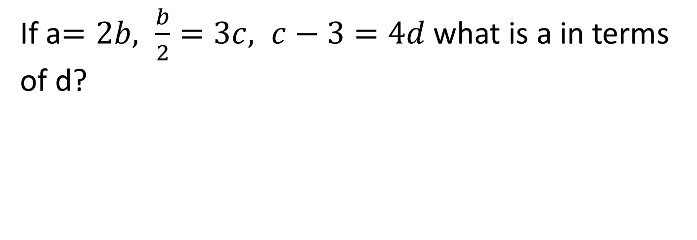
Problem 10
If a$=2b, \frac{b}{2}=3c, c−3=4d$what is a in terms of d?
Copyright © 2015 by the Washington Student Math Association

Slide 11

Problem 11
Solve for x: $9x^{2}+6x+1=16$
Copyright © 2015 by the Washington Student Math Association

Slide 12
Problem 12
Sam got a 77, 83, 86 on three of his math tests. He has 5 more tests left and by the end of the five tests, he wants to get an average of 92 points on the 8 tests. Is this possible given that the max number of points he can get is 100? If yes, give the average of the 5 tests that he must score at least. If no, write no.
Copyright © 2015 by the Washington Student Math Association

Slide 13
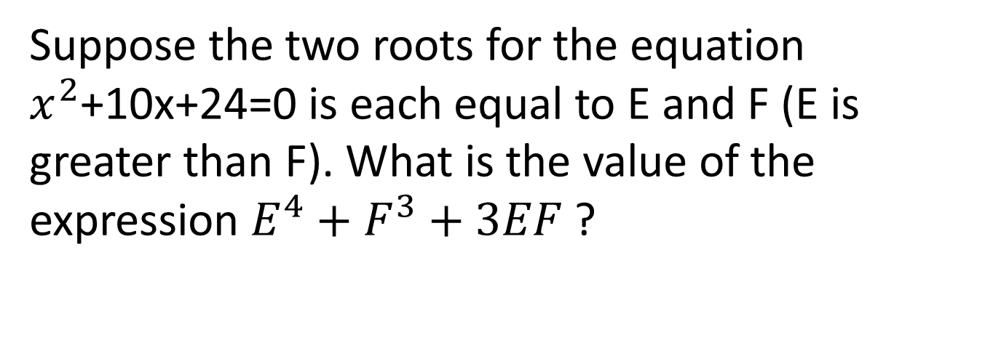
Problem 13
Suppose the two roots for the equation $x^{2}$+10x+24=0 is each equal to E and F (E is greater than F). What is the value of the expression $E^{4}+F^{3}+3EF$?
Copyright © 2015 by the Washington Student Math Association

Slide 14
Problem 14
If the ratios of the angles in a triangle are 3x: 4x: 5x, then what is the value of the largest angle of the triangle?
Copyright © 2015 by the Washington Student Math Association

Slide 15
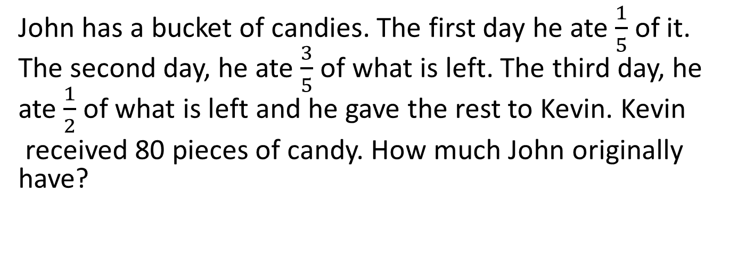
Problem 15
John has a bucket of candies. The first day he ate $\frac{1}{5}$ of it. The second day, he ate $\frac{3}{5}$ of what is left. The third day, he ate $\frac{1}{2}$ of what is left and he gave the rest to Kevin. Kevin
received 80 pieces of candy. How much John originally have?
Copyright © 2015 by the Washington Student Math Association

Slide 16

Problem 16
Simplify
$$\frac{4i+7}{2i −3}$$
Copyright © 2015 by the Washington Student Math Association

