Slide 1

Elimination Tournament
Round 5
4th Annual WSMA Math Bowl
March 29, 2014
This test material is copyright © 2014 by the Washington Student Math Association and may not be distributed or reproduced other than for nonprofit educational purposes without the expressed written permission of WSMA. www.wastudentmath.org.

Slide 2
Problem 1
If there are 4 Mugwumps in a Thugwump and 5 Pugwumps in a Thugwump, how many Mugwumps are in 20 Pugwumps?
Copyright © 2014 by the Washington Student Math Association

Slide 3
Problem 2
Jonas and Julia are going to the movies. If Jerry is supposed to work at the movie theater 4 random days a week, but only shows up to work 4/7ths of the time, what is the chance that Jonas and Julia see Jerry?
Copyright © 2014 by the Washington Student Math Association

Slide 4
Problem 3
Romil solved 11 problems on BNG. The BNG Consists of 15 ordered, numbered questions. It is known that he did not solve at least 9 problems in a row. What is the number of ways he could of solved 11 problems?
Copyright © 2014 by the Washington Student Math Association

Slide 5
Problem 4
Circle A and circle B have two different external tangents, each of length 10 and 15. What is the product of their radi?
Copyright © 2014 by the Washington Student Math Association

Slide 6
Problem 5
How many distinct full houses can be created with a standard deck of 52 cards? A full house is a combination of 3 cards of the same number and 2 other cards of a different number.
Copyright © 2014 by the Washington Student Math Association

Slide 7
Problem 6
Three circles with radius 1 are drawn such that they all pass through the centers of the other two circles. What is the area of the region shared by all three?
Copyright © 2014 by the Washington Student Math Association

Slide 8
Problem 7
What is the difference between the number of possible ways to divide 9 books into groups of 2, 3, and 4 and the number of ways to split them into groups of 3, 3, and 3 books?
Copyright © 2014 by the Washington Student Math Association

Slide 9
Question 8
Zach is distributing candy to a number of children. If he gives 3 pieces of candy to each child, he will have 8 pieces that are not distributed. If he distributes 5 pieces per child, the last child will receive less than 5 pieces. Find the sum of all possible numbers of children.
Copyright © 2014 by the Washington Student Math Association

Slide 10
Question 9
Steven, Andrew, and Zach are playing a game. Steven selects an integer from 1-100. Andrew then selects a different integer in that range. If Zach selects a prime number so that the sum of his number and either Steven's or Andrew's number is divisible by the unselected number, what is the smallest possible sum of all three numbers?
Copyright © 2014 by the Washington Student Math Association

Slide 11
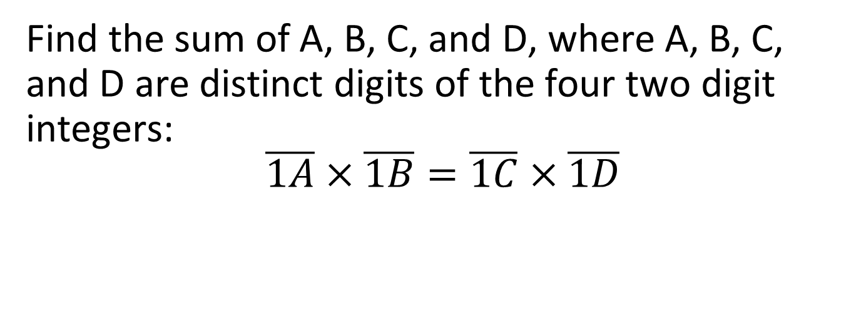
Question 10
Find the sum of A, B, C, and D, where A, B, C, and D are distinct digits of the four two digit integers:
$$\overline{1A}×\overline{1B}=\overline{1C}×\overline{1D}$$
Copyright © 2014 by the Washington Student Math Association

Slide 12
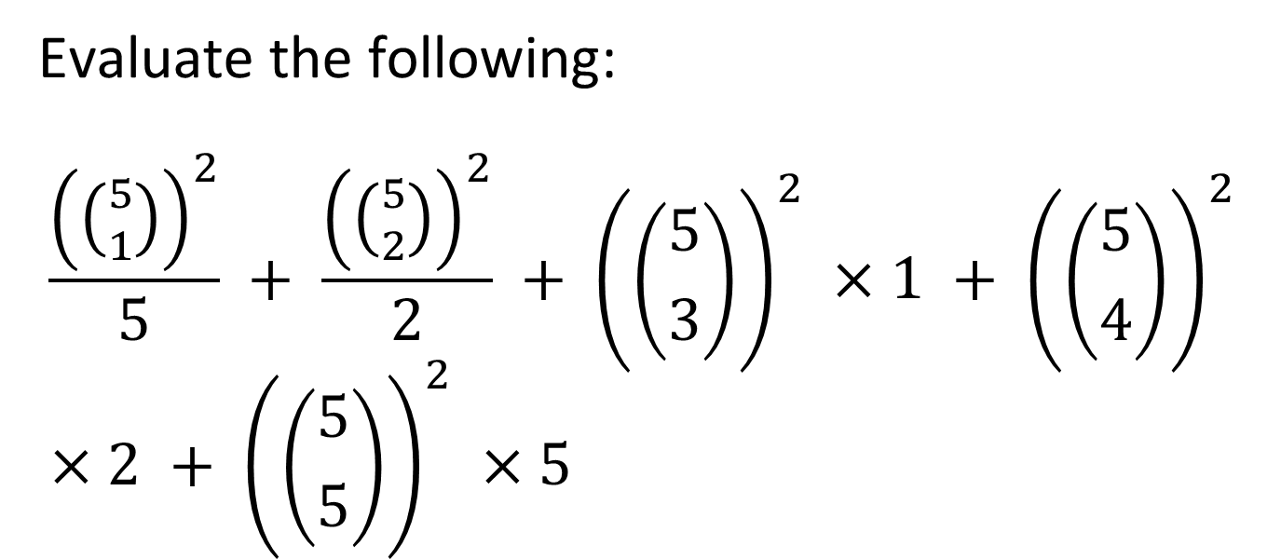
Question 11
Evaluate the following:
$$\frac{{\left(\left({5 \atop 1}\right)\right)}^{2}}{5} + \frac{{\left(\left({5 \atop 2}\right)\right)}^{2}}{2} + {\left(\left({5 \atop 3}\right)\right)}^{2} ×1 + {\left(\left({5 \atop 4}\right)\right)}^{2} ×2 + {\left(\left({5 \atop 5}\right)\right)}^{2} ×5$$
Copyright © 2014 by the Washington Student Math Association

Slide 13
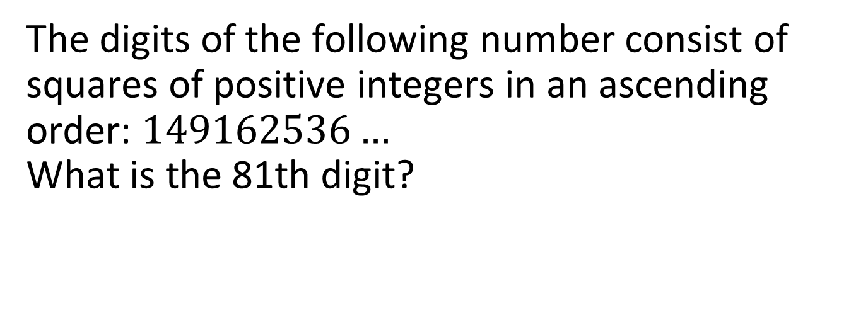
Question 12
The digits of the following number consist of squares of positive integers in an ascending order: $149162536…$
What is the 81th digit?
Copyright © 2014 by the Washington Student Math Association

Slide 14
Question 13
Find the prime factorization of 15598.
Copyright © 2014 by the Washington Student Math Association

Slide 15
Question 14
Find the sum of the cosines of the angles of a triangle with side lengths 5, 7, and 5.
Copyright © 2014 by the Washington Student Math Association

Slide 16

Question 15
Find the value of$n$ that satisfies the following equation:
$$3^{n}\text{+}4^{n}\text{+}5^{n}\text{+}6^{n}\text{= 67106}$$
Copyright © 2014 by the Washington Student Math Association

Slide 17
Question 16
If the median of a right triangle is 5 cm, and the altitude to the hypotenuse is 4 cm, what is the area of the triangle?
Copyright © 2014 by the Washington Student Math Association

Slide 18
Question 17
If there are 4 green balls in jar 1, 6 blue balls in jar 1, 7 blue balls in jar 2, and 3 green balls in jar 2, and Steven takes one ball from jar one and moves it to jar two, what is the chance that he gets a blue ball from jar two?
Copyright © 2014 by the Washington Student Math Association

