Slide 1

Elimination Tournament
Round 3
4th Annual WSMA Math Bowl
March 29, 2014
This test material is copyright © 2014 by the Washington Student Math Association and may not be distributed or reproduced other than for nonprofit educational purposes without the expressed written permission of WSMA. www.wastudentmath.org.

Slide 2

Problem 1
Solve the following equation: $\sqrt{2x+5}=3$
Copyright © 2014 by the Washington Student Math Association

Slide 3
Problem 2
3 players from 9 football players and 5 basketball players are to be chosen. How many ways can we do this given that at least one person must be selected from each sport?
Copyright © 2014 by the Washington Student Math Association

Slide 4

Problem 3
Find the remainder when $f\left(x\right)=x^{3}+3x^{2}+3x+1$ is divided by $(x−10)$.
Copyright © 2014 by the Washington Student Math Association

Slide 5
Problem 4
Foris mixed solution A, which has a sugar concentration of 15%, and solution B, which has a sugar concentration of 24%, with a respective ratio of 3:7. Find the ratio of the total amount of sugar to the total amount of the solution.
Copyright © 2014 by the Washington Student Math Association

Slide 6
Problem 5
A snail crawls up the side of a 5 foot well. Each day, the snail climbs 1 foot, and each night, it slips down 5 inches. If he starts climbing on day 1, on which day will he escape?
Copyright © 2014 by the Washington Student Math Association

Slide 7
Problem 6
What is the largest prime number less than 1000?
Copyright © 2014 by the Washington Student Math Association

Slide 8
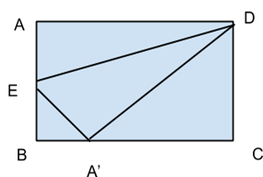
Problem 7
Triangle AED is folded along line ED so that point A’ touches line BC. If AB=4 and AD=5, find the length of BA’ .
Copyright © 2014 by the Washington Student Math Association

Slide 9
Extra Question
How many triangulations of a regular hexagon exist? A Triangulation is defined as a set of lines between non-adjacent vertices that divide the hexagon entirely into triangles.
Copyright © 2014 by the Washington Student Math Association

