Slide 1

Elimination Tournament
Round 3
3nd Annual WSMA Math Bowl
March 2, 2013
This test material is copyright © 2013 by the Washington Student Math Association and may not be distributed or reproduced other than for nonprofit educational purposes without the expressed written permission of WSMA. www.wastudentmath.org.

Slide 2
Problem 1
Square ABCD in the coordinate plane has three of its vertices at points A(1, 3), B(5, 7) and C(9, 3). Find the coordinates of vertex D.
Copyright © 2013 by the Washington Student Math Association

Slide 3
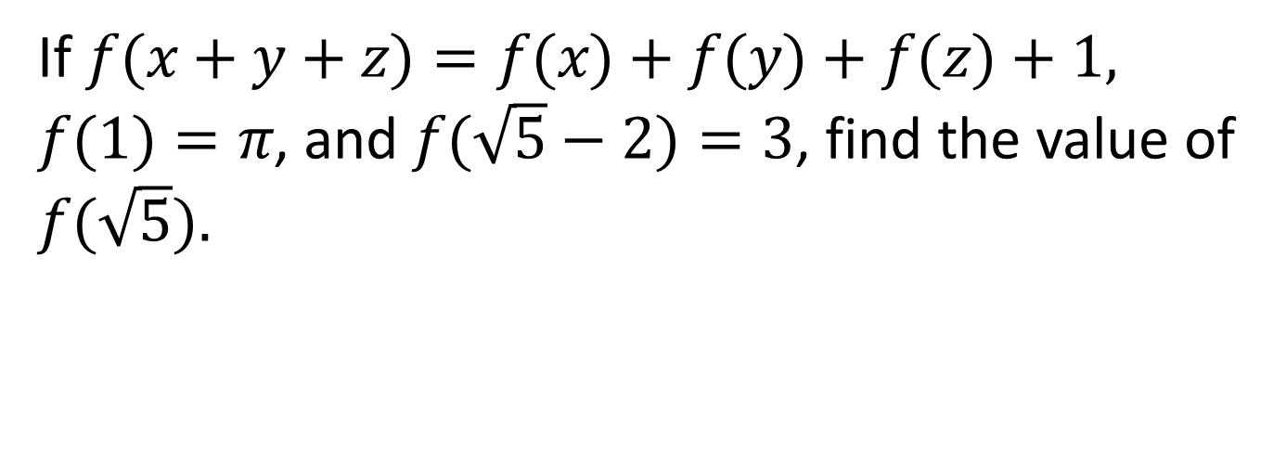
Problem 2
If $f(x+y+z)=f(x)+f(y)+f(z)+1, f(1)=π$, and $f(\sqrt{5}−2)=3$, find the value of $f(\sqrt{5}).$
Copyright © 2013 by the Washington Student Math Association

Slide 4
Problem 3
There are 10 Guardian Angels and 12 Demons under the temple of WSMA. Two beings, chosen among them, are selected to be sent to Evan. When Evan asks truth-telling WSMA members if at least one Demon was selected, the members reply yes. What is the probability that both selected beings are Demons?
Copyright © 2013 by the Washington Student Math Association

Slide 5
Problem 4
3 Siege Tanks attack 12 Zerglings, killing 2 of them and damaging the rest so that the remaining 10 Zerglings have unequal amounts of health remaining. How many ways can Arjun divide the remaining Zerglings into 3 groups of 3, 3 and 4 Zerglings, respectively?
Copyright © 2013 by the Washington Student Math Association

Slide 6

Problem 5
If $1<x<3,$ simplify $\sqrt{1−2x+x^{2}}$ + $\sqrt[4]{{(x^{2}−6x+9)}^{2}}$.
Copyright © 2013 by the Washington Student Math Association

Slide 7

Problem 6
Solve the following equation for x: $987x^{2}−251x−736=0$.
Copyright © 2013 by the Washington Student Math Association

Slide 8
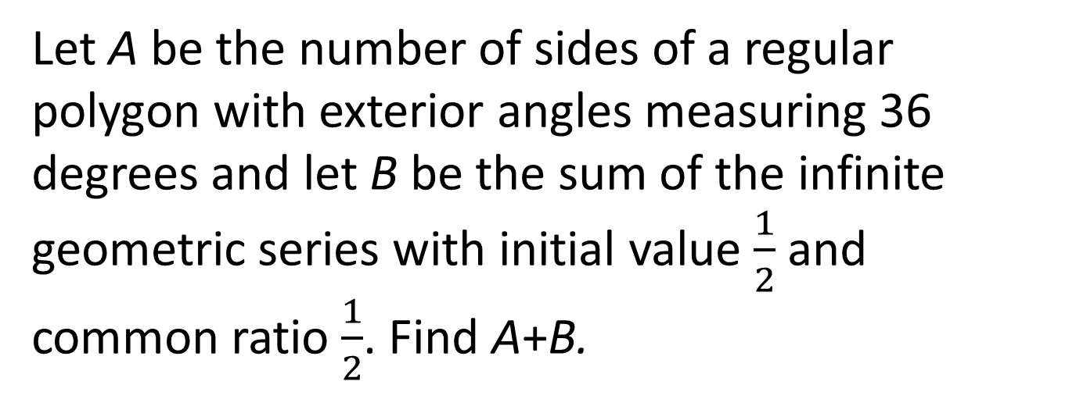
Problem 7
Let A be the number of sides of a regular polygon with exterior angles measuring 36 degrees and let B be the sum of the infinite geometric series with initial value $\frac{1}{2}$ and common ratio $\frac{1}{2}$. Find A+B.
Copyright © 2013 by the Washington Student Math Association

Slide 9
Problem 8
Evaluate the following: 1³+2³+3³+…+15³
Copyright © 2013 by the Washington Student Math Association

Slide 10

Problem 9
The line $y=2x+b$passes through the points $(−1, 3)$ and $(a,−3)$. Find the value of $\frac{b}{a}$
Copyright © 2013 by the Washington Student Math Association

Slide 11
Extra Question
At 7 p.m., Brian realizes he needs to prepare a presentation for 8 a.m. the next day. His productivity is currently 90% and it decreases to 75% after 10 p.m. and it decreases again to 50% after 3 a.m. If he starts working right away and finishes at 8 a.m., how much time would he have saved by not procrastinating and working at 100% productivity? Express your answer as a decimal.
Copyright © 2013 by the Washington Student Math Association

