Slide 1

Elimination Tournament
Round 2
3nd Annual WSMA Math Bowl
March 2, 2013
This test material is copyright © 2013 by the Washington Student Math Association and may not be distributed or reproduced other than for nonprofit educational purposes without the expressed written permission of WSMA. www.wastudentmath.org.

Slide 2
Problem 1
The sum of three positive integers is 1111. What is the greatest possible value for the greatest common factor of the three integers?
Copyright © 2013 by the Washington Student Math Association

Slide 3

Problem 2
Find the value of $p+q$ if p, q, and $p^{q}+q^{p}$ are all prime numbers.
Copyright © 2013 by the Washington Student Math Association

Slide 4
Problem 3
Find the number of rectangles that can be formed from the diagram below:
Copyright © 2013 by the Washington Student Math Association

Slide 5
Problem 4
What is the smallest positive integer x for which x² + x + 41 is a composite number?
Copyright © 2013 by the Washington Student Math Association

Slide 6
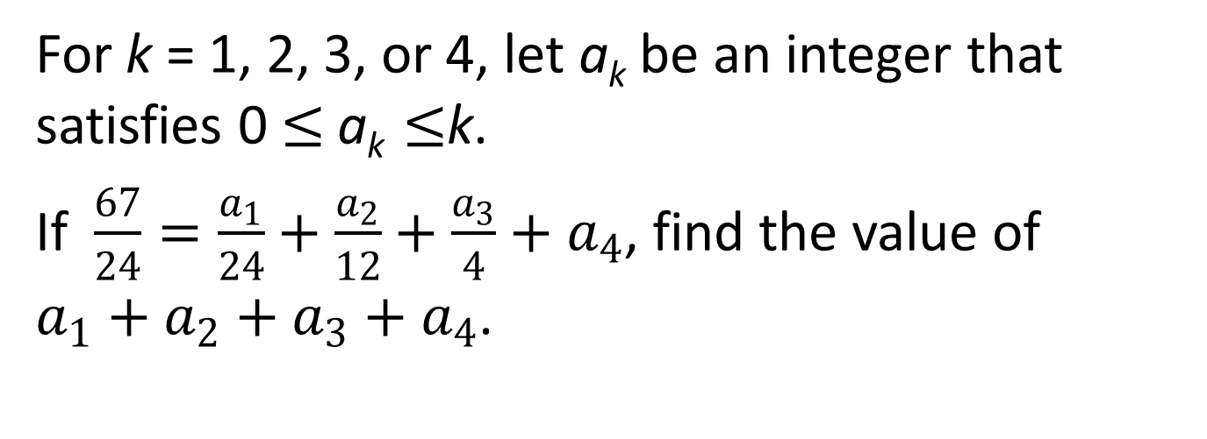
Problem 5
For k = 1, 2, 3, or 4, let a_{k} be an integer that satisfies 0$≤$ a_{k} $≤$k.
If $\frac{67}{24}=\frac{a_{1}}{24}+\frac{a_{2}}{12}+\frac{a_{3}}{4}+a_{4}$, find the value of $a_{1}+a_{2}+a_{3}+a_{4}$.
Copyright © 2013 by the Washington Student Math Association

Slide 7
Problem 6
What is the sum of the maximum number of regions and points of intersection formed if four lines lie on a plane?
Copyright © 2013 by the Washington Student Math Association

Slide 8

Problem 7
How many times will the function $f\left(x\right)= {2x}^{2 }−x+19$ intersect the x-axis?
Copyright © 2013 by the Washington Student Math Association

Slide 9
Problem 8
Water is flowing into a cylindrical can at a rate of 3 cubic centimeters per second. If the can has a base with radius of 5 cm, at what rate is the height of the water in the can increasing? Express your answer in terms of centimeters per second.
Copyright © 2013 by the Washington Student Math Association

Slide 10
Problem 9
Susan has 4 pigs, and two of them are twins. The youngest pig is 1 year old while the oldest one is 2 years younger than 3 times the age of the twin pigs. The sum of the ages of the pigs is 29 years. Find the age, in years, of the twin pigs.
Copyright © 2013 by the Washington Student Math Association

Slide 11
Extra Question
Daniel has 3 different Taylor Swift songs, 1 Straight No Chaser song, and 4 different Hans Zimmer songs on his playlist. What is the probability that, when he shuffles this playlist, the Taylor Swift songs will end up together?
Copyright © 2013 by the Washington Student Math Association

