Slide 1

Elimination Tournament
Round 1
3nd Annual WSMA Math Bowl
March 2, 2013
This test material is copyright © 2013 by the Washington Student Math Association and may not be distributed or reproduced other than for nonprofit educational purposes without the expressed written permission of WSMA. www.wastudentmath.org.

Slide 2
Problem 1
A video rental store has two rental plans. Plan A has a yearly payment of $30 and each video can be rented for $2.50. Plan B has a yearly payment of $25 and each video can be rented for $3.50. If you intend on renting 40 videos over the next two years, which plan will be cheaper?
Copyright © 2013 by the Washington Student Math Association

Slide 3
Problem 2
You have a standard deck of 52 playing cards. What is the probability of drawing a royal card (J, Q, K) that is not a spade? Simplify your answer as a fraction.
Copyright © 2013 by the Washington Student Math Association

Slide 4

Problem 3
Find the 7th term of the following geometric sequence: $1, −3, 9…$.
Copyright © 2013 by the Washington Student Math Association

Slide 5
Problem 4
Find the sum of the prime factors of 2013.
Copyright © 2013 by the Washington Student Math Association

Slide 6
Problem 5
Find the area of a triangle whose vertices in the Cartesian coordinate plane are (1, 2), (3, 12), and (6, 12).
Copyright © 2013 by the Washington Student Math Association

Slide 7
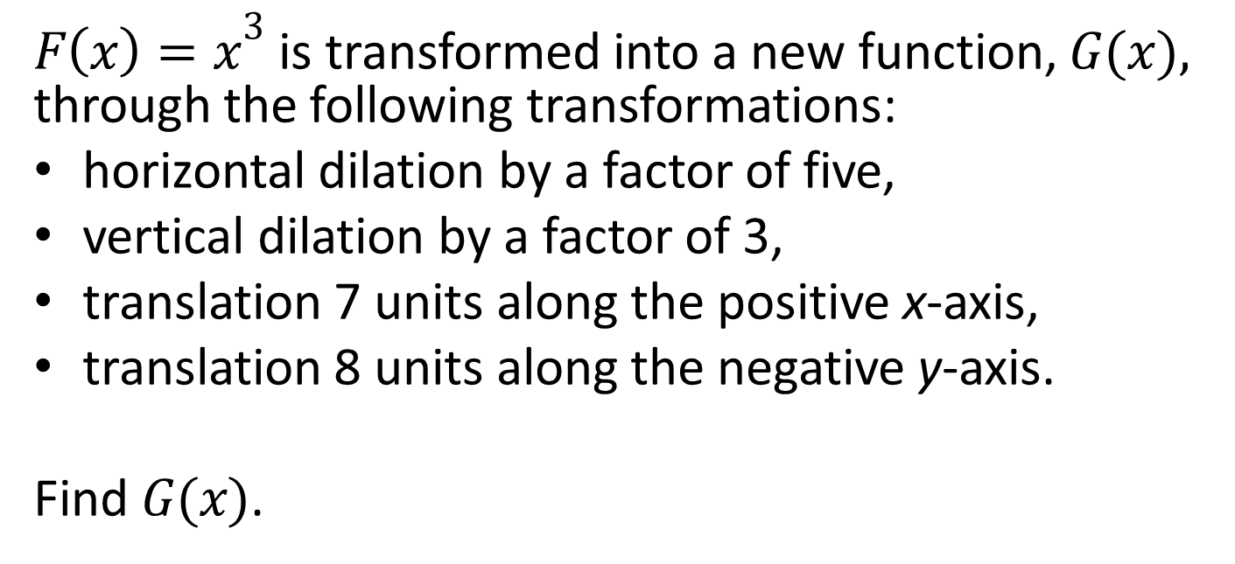
Problem 6
${F\left(x\right)=x}^{3}$ is transformed into a new function, $G(x),$ through the following transformations:
horizontal dilation by a factor of five,
vertical dilation by a factor of 3,
translation 7 units along the positive x-axis,
translation 8 units along the negative y-axis.
Find $G(x)$.
Copyright © 2013 by the Washington Student Math Association

Slide 8
Problem 7
A farmer has 40 feet of fencing. If he can only create a rectangle with integer side lengths, what is the difference between the maximum and minimum areas the farmer could enclose?
Copyright © 2013 by the Washington Student Math Association

Slide 9
Problem 8
Angle A of triangle ABC is divided by an angle bisector that intersects with side BC at point D. If AB=13, BD=10, DC=2.3, and AC=2, find the length of AD.
Copyright © 2013 by the Washington Student Math Association

Slide 10

Problem 9
Solve the following equation:
$$\sqrt{x+3}−\sqrt{x−3}=1$$
Copyright © 2013 by the Washington Student Math Association

Slide 11
Extra Question
Triangle OAB is positioned on a Cartesian plane where O(0,0), A(2,4), and B(3,1). If the line y=kx passes through point O and intersects with AB so that the area of triangle OAB is split into two triangles with equal areas, find the value of k.
Copyright © 2013 by the Washington Student Math Association

