Slide 1

Mental Math
3rd Annual WSMA Math Bowl
March 2, 2013
This test material is copyright © 2013 by the Washington Student Math Association and may not be distributed or reproduced other than for nonprofit educational purposes without the expressed written permission of WSMA. www.wastudentmath.org.

Slide 2
Problem 1
How many multiples of 2 but not 3 are there from 1 to 1000 inclusive?
Copyright © 2013 by the Washington Student Math Association

Slide 3
Problem 2
Find the units digit of 2⁸¹.
Copyright © 2013 by the Washington Student Math Association

Slide 4
Problem 3
How many diagonals can be drawn in a dodecagon?
Copyright © 2013 by the Washington Student Math Association

Slide 5
Problem 4
Find the fifth pentagonal number.
Copyright © 2013 by the Washington Student Math Association

Slide 6

Problem 5
Convert $\sqrt{{524}_{6}}$ into a base 3 number.
Copyright © 2013 by the Washington Student Math Association

Slide 7
Problem 6
What is the probability of getting a sum of 5 when rolling three fair standard six-sided dice?
Copyright © 2013 by the Washington Student Math Association

Slide 8
Problem 7
Compute the following sum:
1+ 4 + 7 + 10 + 13 + 16 + 19 + 22 + 25 + 28 + 31.
Copyright © 2013 by the Washington Student Math Association

Slide 9

Problem 8
If x is a real number, find the minimum value of the following function: $f\left(x\right)=\text{x}\text{2}+6x+9$.
Copyright © 2013 by the Washington Student Math Association

Slide 10
Problem 9
If 2x+4y= -6, find the value of x²+3xy+2y²+4x+5y+3.
Copyright © 2013 by the Washington Student Math Association

Slide 11
Problem 10
There are 53 high school students taking at least one of Advanced Placement chemistry, calculus, or physics. 28 students take AP chemistry, 24 students take AP calculus, and 26 students take AP physics. 6 students take both AP chemistry and AP calculus, 9 students take AP calculus and AP physics, and 10 students take AP chemistry and AP physics. How many students take all three classes?
Copyright © 2013 by the Washington Student Math Association

Slide 12
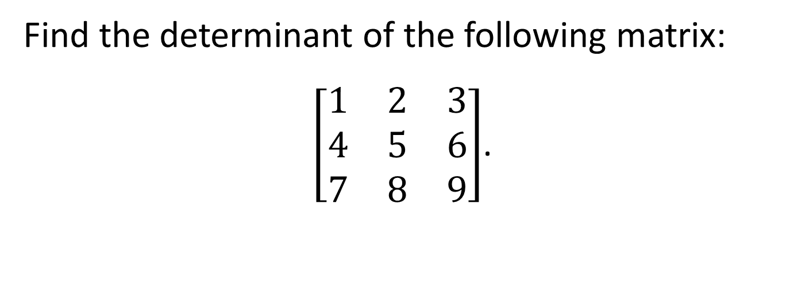
Problem 11
Find the determinant of the following matrix:
$\left[\begin{matrix}1 & 2 & 3 \\ 4 & 5 & 6 \\ 7 & 8 & 9\end{matrix}\right]$.
Copyright © 2013 by the Washington Student Math Association

Slide 13
Problem 12
x is a positive integer less than 400 that has a remainder of 1 when divided by 2, 3, 4, 5, and 6. If x is divisible by 7, find x.
Copyright © 2013 by the Washington Student Math Association

Slide 14

Problem 13
Evaluate the following infinite series: $4−\frac{8}{3}+\frac{16}{9}−\frac{32}{27}+…$.
Copyright © 2013 by the Washington Student Math Association

Slide 15
Problem 14
Find the surface area of a hemisphere with radius 50.
Copyright © 2013 by the Washington Student Math Association

Slide 16
Problem 15
How many arrangements of the letters in the word “MATHBOWL” are possible?
Copyright © 2013 by the Washington Student Math Association

Slide 17

Problem 16
How many real values of x satisfy the equation $\sqrt{x+3}=x+k$ if $k<3$?
Copyright © 2013 by the Washington Student Math Association

