Slide 1
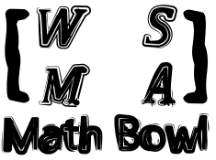
Elimination Tournament
Final Round
3nd Annual WSMA Math Bowl
March 2, 2013
This test material is copyright © 2013 by the Washington Student Math Association and may not be distributed or reproduced other than for nonprofit educational purposes without the expressed written permission of WSMA. www.wastudentmath.org.

Slide 2
Problem 1
In triangle ABC, D is the midpoint of BC. A median line is drawn from vertex A in triangle ABC. If AB = 8, AC = 6, BD = 5, and DC = 5, find the value of AD.
Copyright © 2013 by the Washington Student Math Association

Slide 3

Problem 2
Evaluate: $2+\sqrt{2+\sqrt{2+\sqrt{2+…}}}$
Copyright © 2013 by the Washington Student Math Association

Slide 4
Problem 3
On an analog clock, what is the first time after 4 o’clock at which the minute hand and hour hand coincide? Round your answer to the nearest minute.
Copyright © 2013 by the Washington Student Math Association

Slide 5
Problem 4
Find the area of a triangle with side lengths 7, 8, and 9.
Copyright © 2013 by the Washington Student Math Association

Slide 6
Problem 5
The four digit number abba is a multiple of 7. Find the maximum value of a + b.
Copyright © 2013 by the Washington Student Math Association

Slide 7

Problem 6
If $\frac{a + b}{2}= \frac{b +c}{4}=\frac{c + a}{5}$, find the ratio a:b:c.
Copyright © 2013 by the Washington Student Math Association

Slide 8

Problem 7
If 1.23^{x} = 100 and 0.00123^{y} = 100, find the value of $\frac{1}{x}−\frac{1}{y}$.
Copyright © 2013 by the Washington Student Math Association

Slide 9
Problem 8
Steven and Andrew are creating math problems for WSMA. Steven works for 2 days and rests the next day. Andrew works for 5 days and rests the next 2 days. If they start on the same day, after how many days will they have rested simultaneously for the 5th time?
Copyright © 2013 by the Washington Student Math Association

Slide 10
Problem 9
The roots of the equation x³ – 3x² – 6x + k = 0 form an arithmetic sequence. Find the value of k.
Copyright © 2013 by the Washington Student Math Association

Slide 11
Problem 10
Steven and Andrew plan to meet at WSMA to attend the Math Bowl. Instead of determining a meeting time, Steven and Andrew each plan to arrive at some time between 12pm and 2pm, inclusive. After they arrive, Steven and Andrew will wait for 15 and 30 minutes respectively before leaving if the other does not show up. What is the probability that Steven and Andrew will meet and attend the Math Bowl together?
Copyright © 2013 by the Washington Student Math Association

Slide 12
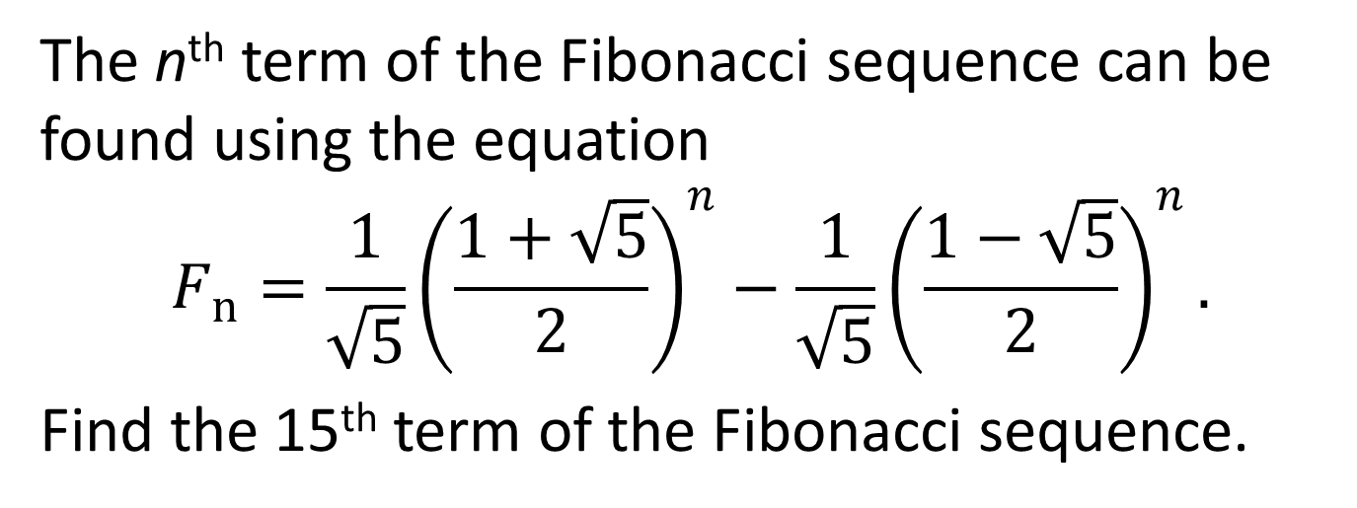
Problem 11
The n^{th} term of the Fibonacci sequence can be found using the equation
$$F_{n}=\frac{1}{\sqrt{5}}{\left(\frac{1+\sqrt{5}}{2}\right)}^{n}−\frac{1}{\sqrt{5}}{\left(\frac{1−\sqrt{5}}{2}\right)}^{n}.$$
Find the 15th term of the Fibonacci sequence.
Copyright © 2013 by the Washington Student Math Association

Slide 13
Problem 12
Find the sum of all four-digit palindromes.
Copyright © 2013 by the Washington Student Math Association

Slide 14
Problem 13
Two cups are placed on a table. Cup A contains 100g of saltwater with an x% concentration while cup B contains 200g of saltwater with 12.5% concentration. When the two solutions inside the two cups are mixed, the solution will have a concentration of 30%. Find the value of x.
Copyright © 2013 by the Washington Student Math Association

Slide 15
Problem 14
A leaky container can be filled using one or two hoses. It takes 3 hours to fill the container with hose A and 6 hours to fill the container with hose B. However, a hole in the container will empty the full container in 4 hours. How many hours will it take to fill the container using both hoses A and B?
Copyright © 2013 by the Washington Student Math Association

Slide 16
Problem 15
Compute the following infinite sum: 0.4 + 0.01 + 0.006 + 0.0006 + 0.00006 + 0.000006 +….
Copyright © 2013 by the Washington Student Math Association

Slide 17
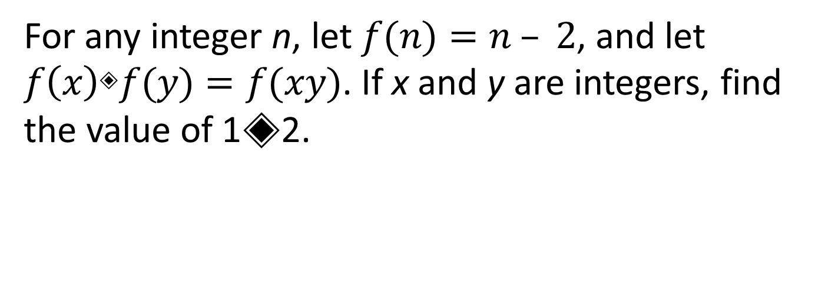
Problem 16
For any integer n, let $f(n)=n – 2$, and let $f\left(x\right)◈f(y)=f(xy)$. If x and y are integers, find the value of 1◈2.
Copyright © 2013 by the Washington Student Math Association

Slide 18
Problem 17
A cylindrical muffin is 2 inches tall and 4 inches in diameter and costs $2.00. If its height decreases in half and the diameter increases by 1 inch, but its price remains the same, how much extra revenue is the greedy cafeteria making, assuming that a muffin costs the same the same amount to make per unit volume? Express your answer to the nearest cent.
Copyright © 2013 by the Washington Student Math Association

Slide 19
Problem 18
Arthi’s dinner was a slice of BBQ chicken pizza and three garlic knots, and cost $4.75. Jin had a slice of Grandma’s pizza and five garlic knots for $3.50, and Sophia had a slice of Grandma’s pizza and two garlic knots for $2.75. How much do two slices of BBQ chicken pizza, one slice of Grandma’s pizza, and seven garlic knots cost?
Copyright © 2013 by the Washington Student Math Association

Slide 20
Problem 19
How many more ways are there to try three flavors out of 50 at Ralph’s Italian Ices than at Baskin Robbins, where there are (theoretically) 31 flavors?
Copyright © 2013 by the Washington Student Math Association

Slide 21
Problem 20
Steven is making honey milk tea. He first makes a 12 oz. cup of tea with no milk, then mixes 8 oz. of tea with 10 oz. of milk. How many times more honey would Hansen get if he added the honey in the 18 oz. cup than if he had added it in the 12 oz. cup? Assume honey takes up a negligible volume.
Copyright © 2013 by the Washington Student Math Association

Slide 22
Problem 21
Susan has a farm with turtles and penguins. If there are 90 legs and 28 heads, how many turtles are there?
Copyright © 2013 by the Washington Student Math Association

Slide 23
Problem 22
Rose has 10 identical York candies that she wants to give to share among her 4 friends. In how many ways can she do this such that each friend receives at least 1 candy?
Copyright © 2013 by the Washington Student Math Association

