Slide 1

Final Round
2nd Annual WSMA Math Bowl
April 28, 2012
This test material is copyright © 2012 by the Washington Student Math Association and may not be distributed or reproduced other than for nonprofit educational purposes without the expressed written permission of WSMA. www.wastudentmath.org.

Slide 2
Problem 1
In a game similar to tic-tac-toe, one point is given for each set of three dots in consecutive horizontal, vertical, or diagonal squares of a 4-by-4 board. If 10 dots are each placed on separate squares of the board, what is the minimum possible number of points on the board? In the example board above there are 5 points, each marked by distinct red lines.
Copyright © 2012 by the Washington Student Math Association

Slide 3
Problem 2
Good Guy Greg, on a bicycle traveling at 15 miles per hour, passes by a train traveling at 40 miles per hour going the opposite way. It takes I minute for the train to completely pass by. How long is the train in feet?
Copyright © 2012 by the Washington Student Math Association

Slide 4
Problem 3
The integers from 1 to 100 inclusive are randomly spaced on a circle. Andrew randomly picks one of the integers from 1 to 99, then moves clockwise to the next integer. If the next integer is not 100, he again moves clockwise to the next integer, and repeats these moves until he reaches 100. What is the expected number of moves Andrew will have to make? (if he picks 100 at the very beginning, he will make 0 moves)
Copyright © 2012 by the Washington Student Math Association

Slide 5
Problem 4
A salt solution containing 6% salt is mixed with 2ml of a salt solution containing 15% salt to obtain a 12% solution. How much of the 6% solution should be used?
Copyright © 2012 by the Washington Student Math Association

Slide 6
Problem 5
Socially Awkward Penguin is silently following Scumbag Steve. The penguin stays still while Steve walks 100 feet north from him, then 80 feet east, and 40 feet south. At the end, what is the sine of the angle between the penguin, Steve, and a line going east from the penguin?
Copyright © 2012 by the Washington Student Math Association

Slide 7
Problem 6
Fred is thinking of four integers whose product is 48. George is thinking of a different set of four integers whose product is also 48. If the sum of George’s numbers is the same as the sum of Fred’s numbers, what is the sum of George’s numbers?
Copyright © 2012 by the Washington Student Math Association

Slide 8

Problem 7
What is the product of the minimum and maximum values of the equation $y=\frac{x^{2}−2x−3}{2x^{2}+2x+1}$?
Copyright © 2012 by the Washington Student Math Association

Slide 9
Problem 8
There is a square of side length 10 meters. Two arcs of radius 10 are drawn from adjacent corners of the square. What is the area, in square meters, of the part of the square not covered by either of the arcs?
Copyright © 2012 by the Washington Student Math Association

Slide 10
Problem 9
An unlimited amount of water is being extracted with machines that fill up a tank. This tank can be filled with 12 machines in 5 hours or 10 machines in 7 hours. What is the least number of machines required to fill up the entire tank in 2 hours?
Copyright © 2012 by the Washington Student Math Association

Slide 11
Problem 10
Forrest opens a 6 inch-long and 9 inch-wide box of circular chocolates. He sees that there is a 2-by-3 array of large circles all tangent to each other and the box, in addition to two small circles in between the large circles, tangent to the 4 surrounding large circles. What is the area of the box not covered by the chocolate circles?
Copyright © 2012 by the Washington Student Math Association

Slide 12
Problem 11
There is a regular hexagon with a circle inscribed and a circle circumscribed. What is the ratio of the area of the large circle to that of the small one?
Copyright © 2012 by the Washington Student Math Association

Slide 13
Problem 12
Rose is selecting 2 numbers from a jar that contains the numbers 1,2,3,4, and 5. What is the probability that the product of the 2 numbers she draws is a prime number?
Copyright © 2012 by the Washington Student Math Association

Slide 14
Problem 13
How many two-digit numbers double or triple when the two digits interchange?
Copyright © 2012 by the Washington Student Math Association

Slide 15
Problem 14
Austin woke up between 7 and 8 AM and noticed that the two hands of a clock coincided. When he arrived at WSMA, he noticed another coincidence of the two hands. In exact hours and minutes, how long did it take for him to arrive at WSMA after waking up? Express your answer in a common fraction.
Copyright © 2012 by the Washington Student Math Association

Slide 16
Problem 15
Find the greatest common divisor of a and b where and a is the rational part of .
Copyright © 2012 by the Washington Student Math Association

Slide 17

Problem 16
Of the first ${10}^{900}$integers, what portion is divisible by 6 but not 15?
Copyright © 2012 by the Washington Student Math Association

Slide 18
Problem 17
WSMA members Steven, Sophia, Andrew, Ashwin, Foris, and Arthi are sitting at a round table with 6 chairs. What is the probability that Ashwin and Sophia will sit together?
Copyright © 2012 by the Washington Student Math Association

Slide 19
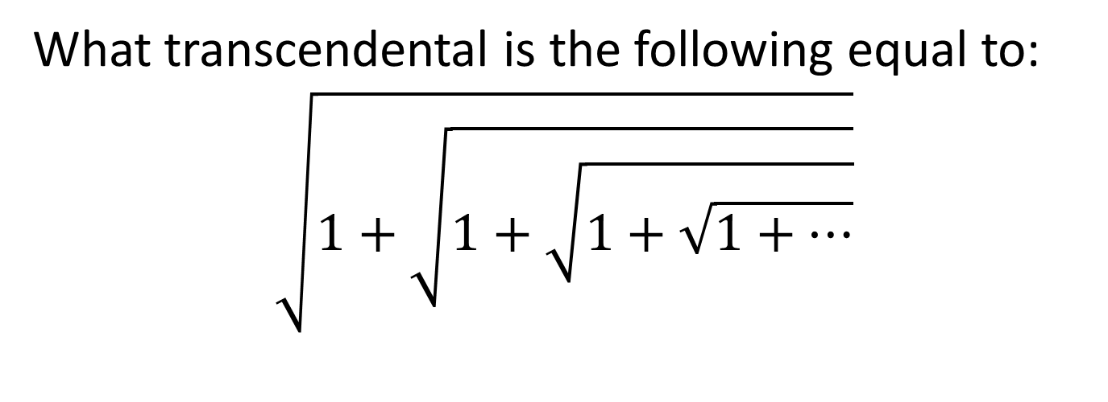
Problem 18
What transcendental is the following equal to:
$$\sqrt{1+\sqrt{1+\sqrt{1+\sqrt{1+…}}}}$$
Copyright © 2012 by the Washington Student Math Association

Slide 20
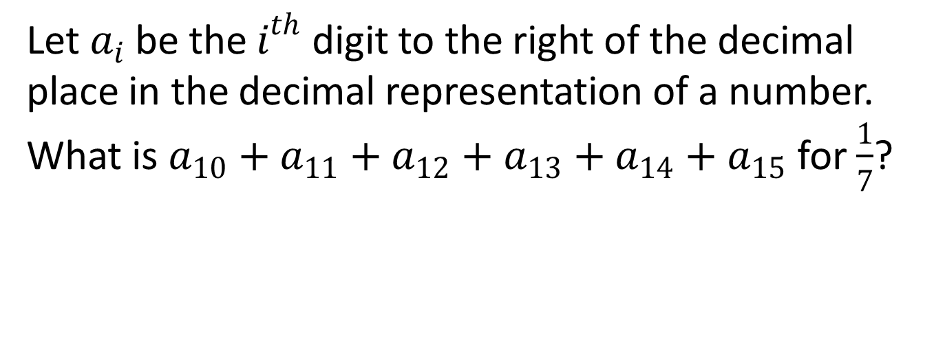
Problem 19
Let $a_{i}$ be the $i^{th}$ digit to the right of the decimal place in the decimal representation of a number. What is $a_{10}+a_{11}+a_{12}+a_{13}+a_{14}+a_{15}$ for $\frac{1}{7}$?
Copyright © 2012 by the Washington Student Math Association

Slide 21
Problem 20
Jane drove her compact car 120 miles home for the weekend and averaged 40 miles per gallon. On the return trip she drove her parents' sedan and averaged only 30 miles per gallon. What was the average gas mileage, in miles per gallon, for the round trip?
Copyright © 2012 by the Washington Student Math Association

Slide 22
Problem 21
In degrees, what is the angle between the minute and hour hand of a clock when it is 1:04 and the clock is 10 minutes late?
Copyright © 2012 by the Washington Student Math Association

Slide 23
Problem 22
If February 13th, 2222 is a Friday, what day is pi-day that year (March 14th, 2222)?
Copyright © 2012 by the Washington Student Math Association

Slide 24
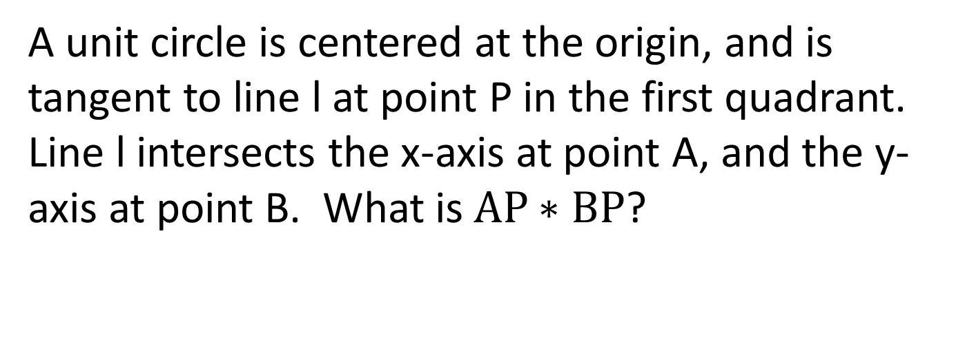
Problem 23
A unit circle is centered at the origin, and is tangent to line l at point P in the first quadrant. Line l intersects the x-axis at point A, and the y-axis at point B. What is$AP∗BP$?
Copyright © 2012 by the Washington Student Math Association

Slide 25
Problem 24
A grocer makes a display of cans in which the top row has one can and each lower row has two more cans than the row above it. If the display contains 100 cans, how many rows does it contain?
Copyright © 2012 by the Washington Student Math Association

Slide 26
Problem 25
Pac-Man is eating and is caught by a ghost, which turns our two-dimensional hero into a cone. The stunned Pac-Man is a sector of radius 10 inches and angle of 270 degrees. What is the volume of the cone Pac-Man?
Copyright © 2012 by the Washington Student Math Association

Slide 27
Problem 26
All the students in an English class took a 100-point test. Five students scored 100, each student scored at least 60, and the mean score was 76. What is the smallest possible number of students in the class?
Copyright © 2012 by the Washington Student Math Association

Slide 28
Problem 27
John and Jane each bought 12 ounces of coffee in a 20-ounce cup. Chris drank 2 ounces of his coffee and then added 2 ounces of cream. Christina added 2 ounces of cream, stirred the coffee well, and then drank 2 ounces. What is the resulting ratio of the amount of cream in Chris’s coffee to that in Christina’s coffee?
Copyright © 2012 by the Washington Student Math Association

Slide 29
Problem 28
In a two-dimensional universe, an alien girl whips her hair back and forth. Her uniformly 10 inch-long hair is attached to the top center of her square head, which has side length 12 inches. In square inches, what is the area that her hair covers as she whips her hair back and forth? Ignore the fact that the head moves.
Copyright © 2012 by the Washington Student Math Association

Slide 30

Problem 29
Solve for x in this equation:
$$2=\frac{1}{1+\frac{1}{1+\frac{1}{1+\frac{1}{x}}}}$$
Copyright © 2012 by the Washington Student Math Association

Slide 31
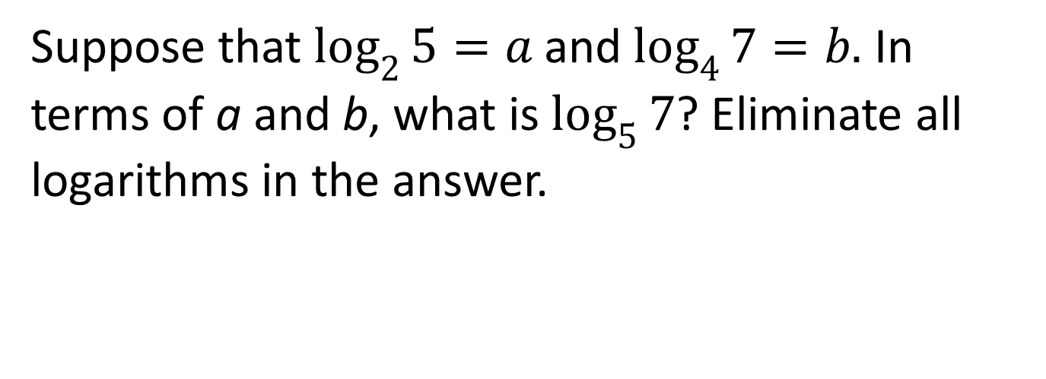
Problem 30
Suppose that $\log_{2}{5}=a$and $\log_{4}{7}=b.$ In terms of a and b, what is $\log_{5}{7}$? Eliminate all logarithms in the answer.
Copyright © 2012 by the Washington Student Math Association

Slide 32
Problem 31
The two digits in Mr. Chan’s age are the same as the digits in Mr. Fore’s age, but in reverse order. In five years Mr. Chan will be twice as old as Mr. Fore will be then. What is the difference in the current ages of Fore and Chan?
Copyright © 2012 by the Washington Student Math Association

Slide 33
Problem 32
How many integers not exceeding 2012 are divisible by 4 and 6 but not 5?
Copyright © 2012 by the Washington Student Math Association

Slide 34
Problem 33
A Girl Scout troop buys 1000 candy bars at a price of ten for 7 dollars. They sell all the candy bars at the price of two for $1.50. What was their profit, in dollars?
Copyright © 2012 by the Washington Student Math Association

Slide 35
Problem 34
Sophia, Ashwin, and Arthi are working to produce problems for Math Bowl. The time it takes for Sophia to do the work is 1/a of the time it takes for Ashwin and Arthi to finish the work. The time it takes for Ashwin to do the work is 1/b of the time it takes for Sophia and Arthi to accomplish the work. How long will Arthi have to work to finish compared to how long it takes when Sophia and Ashwin are working together? Express your answer in terms of a and b.
Copyright © 2012 by the Washington Student Math Association

Slide 36
Problem 35
A
5
F
E
B
D
C
2
2
Given the diagram above, evaluate ED/AE.
Copyright © 2012 by the Washington Student Math Association

