Slide 1

Elimination Round 3
2nd Annual WSMA Math Bowl
April 28, 2012
This test material is copyright © 2012 by the Washington Student Math Association and may not be distributed or reproduced other than for nonprofit educational purposes without the expressed written permission of WSMA. www.wastudentmath.org.

Slide 2
Problem 1
Steven forgot to write down an important phone number. However, he remembers that it started with 206 and that the next 7 digits are formed with the numbers 1, 4, 5, 7, 8, 9 with one appearing twice. If he guesses a phone number, what is the probability that he gets the correct number?
Copyright © 2012 by the Washington Student Math Association

Slide 3
Problem 2
Sean and Ben are running around a track with a perimeter of 500 meters. If they start simultaneously from the start line in the same direction, Ben will pass Sean in 4 minutes. If they run in different directions, they will meet in 2 minutes. What is Ben’s speed in m/s?
Copyright © 2012 by the Washington Student Math Association

Slide 4
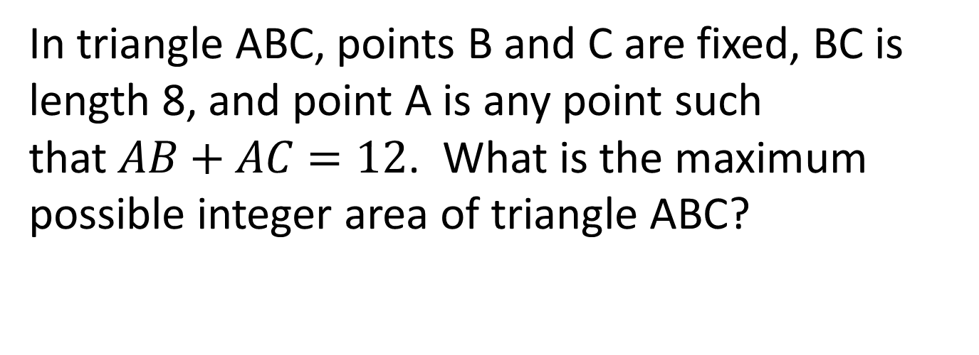
Problem 3
In triangle ABC, points B and C are fixed, BC is length 8, and point A is any point such that$AB+AC=12$. What is the maximum possible integer area of triangle ABC?
Copyright © 2012 by the Washington Student Math Association

Slide 5
Problem 4
Hansen has 10 identical York candies that he wants to share among his 4 friends. In how many ways can he do this such that each friend receives at least 1 candy?
Copyright © 2012 by the Washington Student Math Association

Slide 6
Problem 5
The sum of seven consecutive even integers is 994. How many of these integers have 5 or more factors?
Copyright © 2012 by the Washington Student Math Association

Slide 7
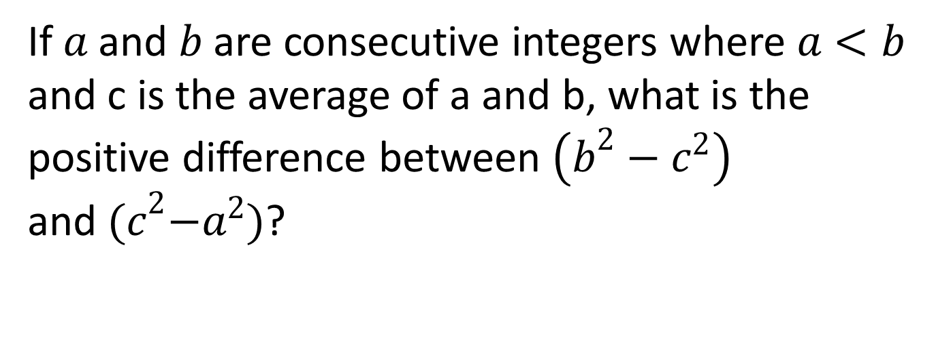
Problem 6
If $a$ and $b$ are consecutive integers where $a<b$ and c is the average of a and b, what is the positive difference between $\left(b^{2}−c^{2}\right)$ and${ (c}^{2}−a^{2})$?
Copyright © 2012 by the Washington Student Math Association

Slide 8
Problem 7
Andrew wants to distribute 12 identical balls into 4 boxes so that each box contains at least 2 balls per box. Samir, however, wants to place the 9 balls into 3 boxes so that there are at least 1 ball per box. What is the sum of the possible ways Andrew and Samir would each distribute the balls?
Copyright © 2012 by the Washington Student Math Association

Slide 9
Problem 8
Let S be a list of positive integers that are not necessary distinct in which the number 38 appears. The arithmetic mean of the numbers in is 29. However, if 38 is removed, the arithmetic mean of the numbers is 28. What is the sum of the digits of the largest number that can appear in S?
Copyright © 2012 by the Washington Student Math Association

Slide 10

Problem 9
How many pairs of integers $(x,y)$ satisfy the following equation: $\left|x−1\right|+\left|y+2\right|=2$?
Copyright © 2012 by the Washington Student Math Association

Slide 11
Problem 10
How many solutions does the equation a+b+c+d+e=21 have where a, b, c, d, and e are all whole numbers?
Copyright © 2012 by the Washington Student Math Association

Slide 12

Problem 11
If$f\left(x\right)=x^{\frac{1}{2}}+x^{\frac{3}{2}}+x^{\frac{5}{2}}+…$, what is$f\left(\frac{1}{4}\right)$?
Copyright © 2012 by the Washington Student Math Association

Slide 13
Problem 12
A scale weight that weighs 13g broke into 3 parts after accidently dropping it on the floor. Surprisingly, the 3 new weights were found to weigh integer values and also capable of measuring any kind of integer weight equal or less than 13g. How much does each scale weight weigh?
Copyright © 2012 by the Washington Student Math Association

