Slide 1

Elimination Round 2
1st Annual WSMA Math Bowl
May 27, 2011

Slide 2

Problem 1
If $a_{k}=\frac{3}{k}−\frac{3}{k+1}$, what is $a_{1}+a_{2}+…+a_{9}+a_{10}?$

Slide 3

Problem 2
If${ 27}^{x}∙{81}^{y^{2}}=3^{18}$, what is the maximum possible value of$x$?

Slide 4
Problem 3
All the students in a calculus class took a 100-point test. Five students scored 100, each student scored at least 60, and the mean score was 80. What is the smallest possible number of students in the class?

Slide 5
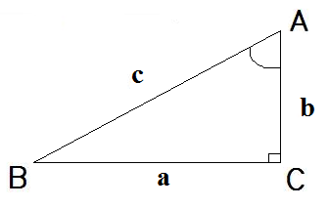

Problem 4
In $⊿ABC$, $a=16$, $\sin{A}=\frac{8}{\sqrt{65}}$, and $\tan{A}=8$. What is the value of $b$?

Slide 6

Problem 5
If$a+b+c=3$ and$a,b,c≥0$, what is the greatest possible value of${ a}^{2}bc+ab^{2}c+abc^{2}$?

Slide 7
Problem 6
In a triangle with integer side lengths, one side is three times as long as a second side, and the length of the third side is 15. What is the greatest possible perimeter of the triangle?

Slide 8
Problem 7
The product of three consecutive positive integers is 8 times their sum. What is the sum of the numbers?

Slide 9
Problem 8
Four distinct circles are drawn in a plane. What is the maximum number of points where at least two of the circles intersect?

Slide 10

Problem 9
If${ x}^{2}+2x−y+17≤0$, what is smallest possible value of $y$?

Slide 11
Problem 10
The two digits in Mr. Reddit’s age are the same as the digits in Mr. Gatsby’s age, but in reverse order. In five years, Mr. Reddit will be twice as old as Mr. Gatsby will be then. What is the difference in their current ages?

Slide 12

Extra Problem
(only if needed)
If the sides of a triangle are in the ratio of $2∶3∶4$, compute the sine of the smallest angle.

