Slide 1

Elimination Round 1
1st Annual WSMA Math Bowl
May 27, 2011

Slide 2
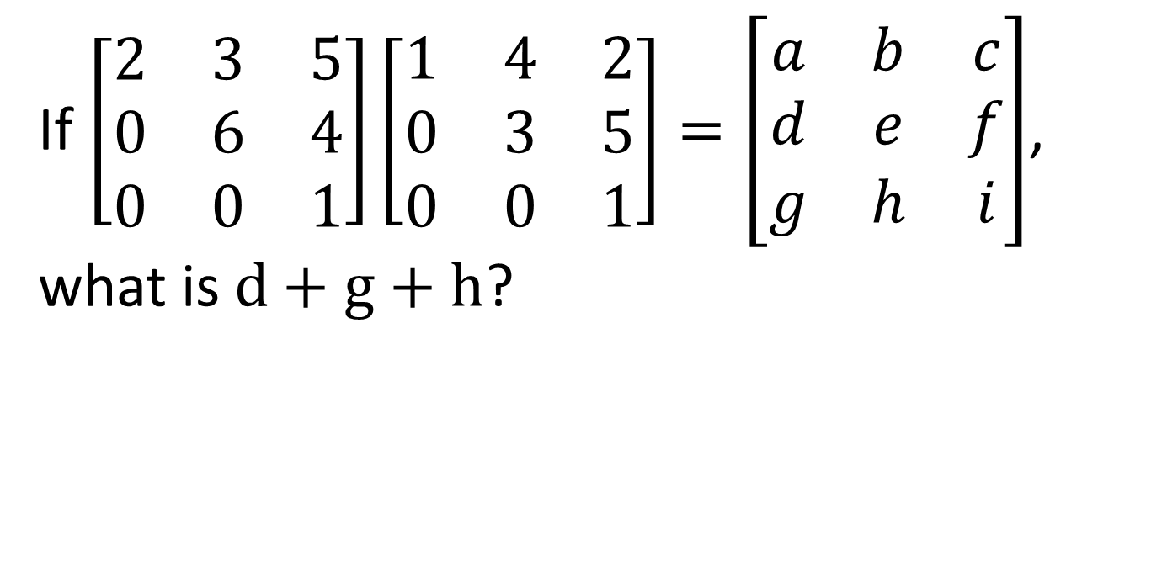
Problem 1
If $\left[\begin{matrix}\begin{matrix}2 & 3 & 5 \\ 0 & 6 & 4 \\ 0 & 0 & 1\end{matrix}\end{matrix}\right]\left[\begin{matrix}\begin{matrix}1 & 4 & 2 \\ 0 & 3 & 5 \\ 0 & 0 & 1\end{matrix}\end{matrix}\right]=\left[\begin{matrix}\begin{matrix}a & b & c \\ d & e & f \\ g & h & i\end{matrix}\end{matrix}\right]$, what is$d+g+h$?

Slide 3
Problem 2
What is the smallest positive integer that has a remainder of 2 when divided by 5, a remainder of 4 when divided by 7, and a remainder of 6 when divided 9?

Slide 4

Problem 3
If$x=\sqrt{−1}$, evaluate the following:
$$\frac{x^{17}−1}{x−1}$$

Slide 5

Problem 4
Name one possible positive integer$n$ for which $n^{2}−n+41$ is composite.

Slide 6
Problem 5
In a triangle of side lengths 5, 12, and 13, what is the product of the radii of the incircle and the circumcircle?

Slide 7
Problem 6
On a 24-hour analog clock, the hour hand completes one revolution in 24 hours instead of 12, and the minute hand completes one revolution in 60 minutes, as usual. At what time or times where the hour and minutes are both integers do the minute and hour hands perfectly overlap?

Slide 8
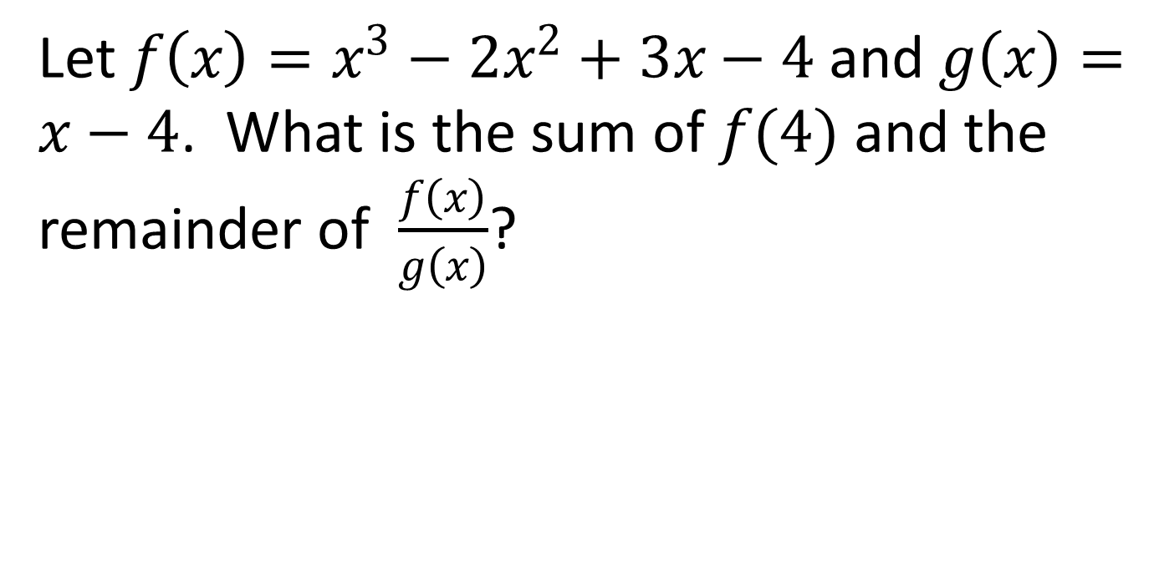
Problem 7
Let $f\left(x\right)=x^{3}−2x^{2}+3x−4$ and$g\left(x\right)=x−4$. What is the sum of $f(4)$ and the remainder of $\frac{f\left(x\right)}{g\left(x\right)}$?

Slide 9

Problem 8
In $∆ABC$, $m∠CBA=60°$, $BC=7$, and $AC=\sqrt{39}$. Find the length of $AB$.

Slide 10

Problem 9
For what positive integer value of $x$ is the inequality ${\left(x+10\right)}^{2}≤{\left(x−12\right)}^{2}$ satisfied?

Slide 11
Problem 10
What is the lateral surface area of the cone formed from a 252-degree sector of a 10-inch radius circle by aligning the two straight sides?

Slide 12

Extra Problem
(only if needed)
The parabola $y=ax^{2}+bx+c$ has vertex $(1, 1)$ and $y$-intercept $(0, −1)$. What is the value of $b$?

