Slide 1

Preliminary Round 3
1st Annual WSMA Math Bowl
May 27, 2011

Slide 2

Problem 1
Evaluate ${(i+1)}^{6}$.

Slide 3

Problem 2
How many integers $x$ satisfy $\sqrt{13}<x^{2}<\sqrt{300}$?

Slide 4
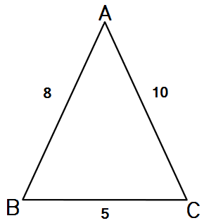
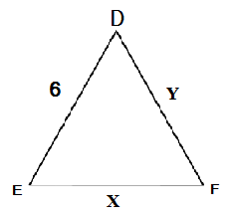
Problem 3
Given that triangles ABC and DEF are similar, find the product of the lengths

Slide 5

Problem 4
If $x$ and $y$ are integers such that $25=y^{2}−x^{2}$, what is the least possible value of $x+y$?

Slide 6

Problem 5
If $f\left(x\right)=1+x+x^{2}$, what is $f(2)∙f\left(−\frac{1}{2}\right)$?

Slide 7
Problem 6
If 7 two-sided coins are flipped, what is the probability that at least 4 are heads?

Slide 8

Problem 7
If $\frac{ab}{c}=\frac{bc}{a}=\frac{ac}{b}=1$, what is $a^{2}+b^{2}+c^{2}$?

Slide 9

Problem 8
Compute the largest possible n such that ${10}^{n}$divides $200!$

Slide 10

Problem 9
What is ${101011}_{2}+{10101}_{2}+{10101}_{4}$ in base four?

Slide 11
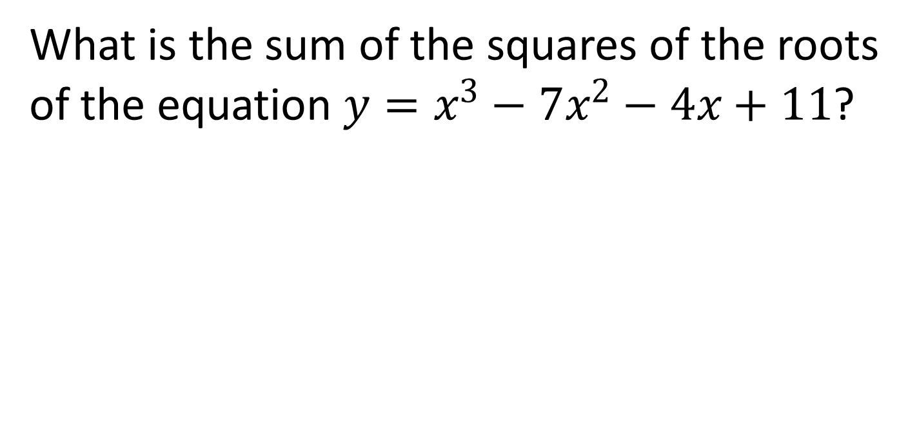
Problem 10
What is the sum of the squares of the roots of the equation $y=x^{3}−7x^{2}−4x+11$?

Slide 12

Extra Problem
(only if needed)
When $−90≤x≤720$ and $x$ is in degrees, how many times does the line $y=\frac{x}{810}$ intersect $y=\sin{x}$?

