Slide 1

Preliminary Round 1
1st Annual WSMA Math Bowl
May 27, 2011

Slide 2
Problem 1
A square has sides of length 10, and a circle centered at one of its vertices has radius 10. What is the area of the union of the regions enclosed by the square and the circle?

Slide 3
Problem 2
Arya rolls a fair regular octahedral die marked with the numbers 1 through 8. Then Zach rolls a fair six-sided die. What is the probability that the product of the two rolls is a multiple of 16?

Slide 4
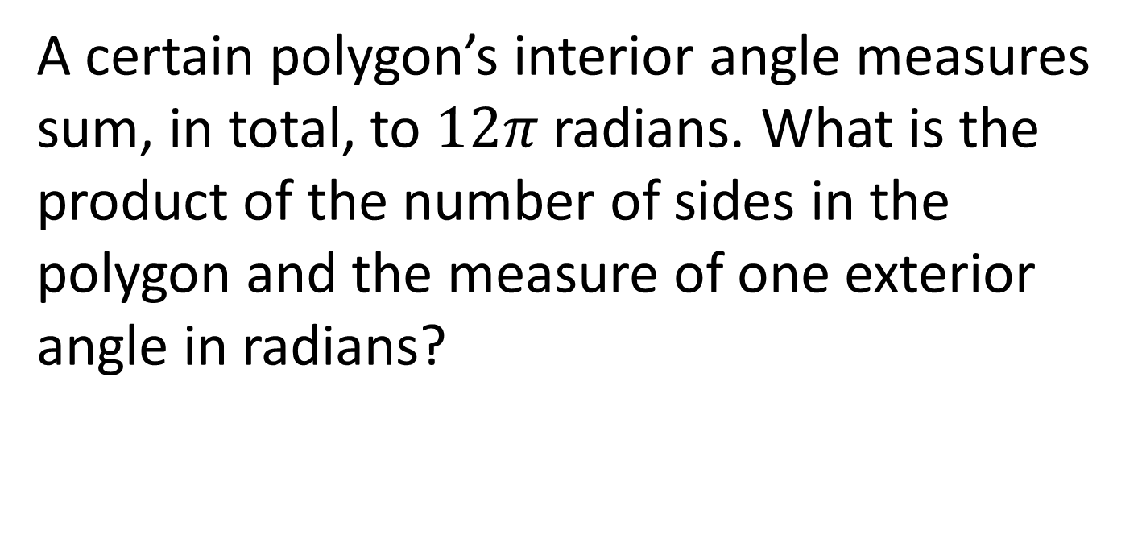
Problem 3
A certain polygon’s interior angle measures sum, in total, to $12π$ radians. What is the product of the number of sides in the polygon and the measure of one exterior angle in radians?

Slide 5
Problem 4
At Mr. Magorium’s Wonder Emporium, 3 zeds cost as much as 2 widgets, and 6 widgets cost as much as 4 junkers. How many zeds cost as much as 18 junkers?

Slide 6
Problem 5
How many ways can you arrange the letters in the word HAMMER if the Ms cannot be immediately next to each other?

Slide 7
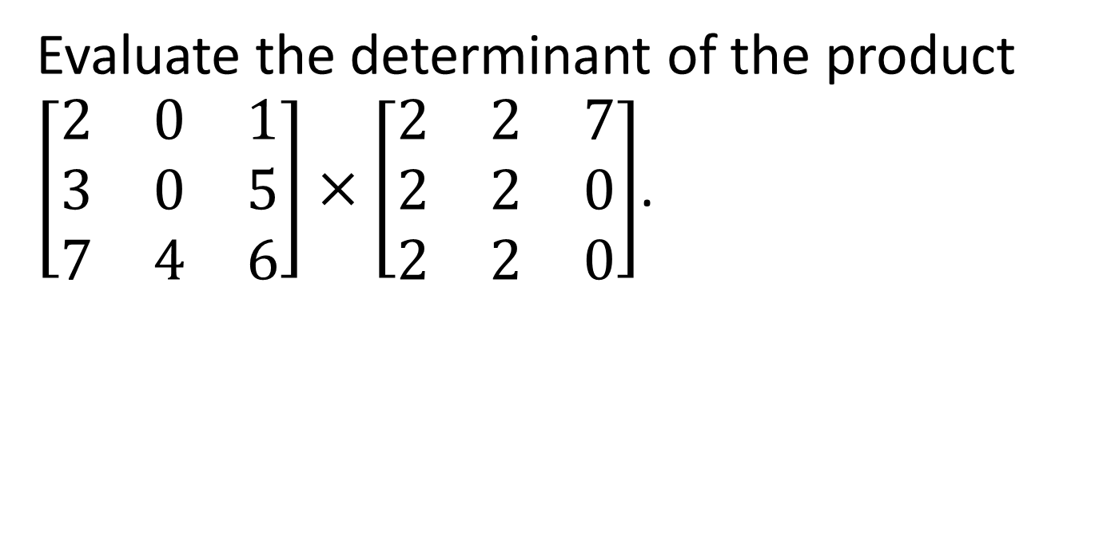
Problem 6
Evaluate the determinant of the product $\left[\begin{matrix}2 & 0 & 1 \\ 3 & 0 & 5 \\ 7 & 4 & 6\end{matrix}\right]×\left[\begin{matrix}2 & 2 & 7 \\ 2 & 2 & 0 \\ 2 & 2 & 0\end{matrix}\right]$.

Slide 8
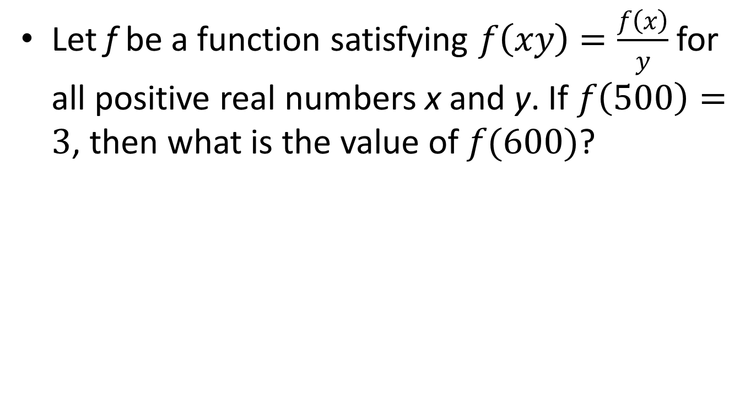
Problem 7
Let f be a function satisfying $f\left(xy\right)=\frac{f\left(x\right)}{y}$ for all positive real numbers x and y. If $f\left(500\right)=3$, then what is the value of $f(600)$?

Slide 9

Problem 8
Evaluate the sum $25+36+…+225$.

Slide 10
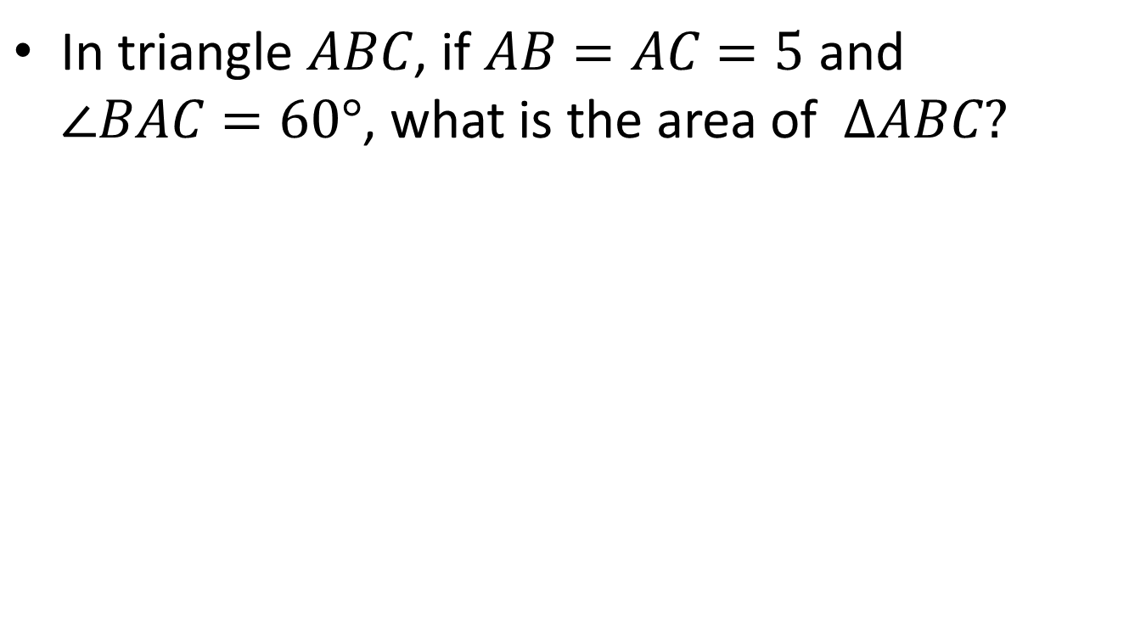
Problem 9
In triangle $ABC$, if $AB=AC=5$ and $∠BAC=60°$, what is the area of $ΔABC?$

Slide 11
Problem 10
A positive 3-digit number is a multiple of 5, its digits sum to 10, and the hundreds digit is one more than the tens digit. Find the hundreds digit.

Slide 12
Extra Problem
(only if needed)
If the sum of a number and its reciprocal is 2, find the sum of the cube of that number and the cube of its reciprocal.

